Slide 1



Device Clinical Bridge (DCB)
Phase 1 IHE Proposal Draft Graphics
October 23, 2014

Slide 2
Team - Recent
VHA (also IHE for some)
Ioana Singureanu
Greg Staudenmaier
Holly Miller
Dan Morford
Catherine Hoang
IHE
Manny Furst
Paul Sherman – Technical Project Manager – IHE Patient Care Device Domain(retired VHA)
John Garguilo (NIST)
Paul Schluter (GE)
Alex Lippitt (HIMSS, IHE)

Slide 3
The Problem – the DCB Challenge (1 of 2)
The general rule today is that while a clinician or provider can view patient data generated by patient care devices in an inpatient setting or outpatient encounter room, but when that same person accesses his or her EHR application that data is not available. Getting semantically correct clinical data from patient care devices into clinical applications is generally not achieved today for a number of reasons:
The applicable nomenclature from medical devices, IEEE 11073 10101, is not one of the Meaningful Use (MU) approved nomenclatures, reducing the incentive to use IEEE 11073 data in clinical applications. The update under review, IEEE 11073 10101a, is also not one of the MU approved nomenclatures.
There are no commonly accepted mappings of IEEE 11073 10101 to Meaningful Use approved nomenclatures (LOINC and SNOMED primarily) for clinical measures although there are vendors who have done so as proprietary interfaces, but there is no reliable way to combine this data given the lack of generally accepted mappings.

Slide 4
The Problem – the DCB Challenge (2 of 2)
Note: There are still many circumstances where the specific numeric measures are not codified in a generally accepted standard, for example the on-Going work with ventilators.
The result is that much of this numeric data generated from medical applications is either not reentered into clinical systems or reentered at significant risk of error. The result is that much of this numeric data generated from medical applications is either not reentered into clinical systems or reentered at significant risk of error.

Slide 5
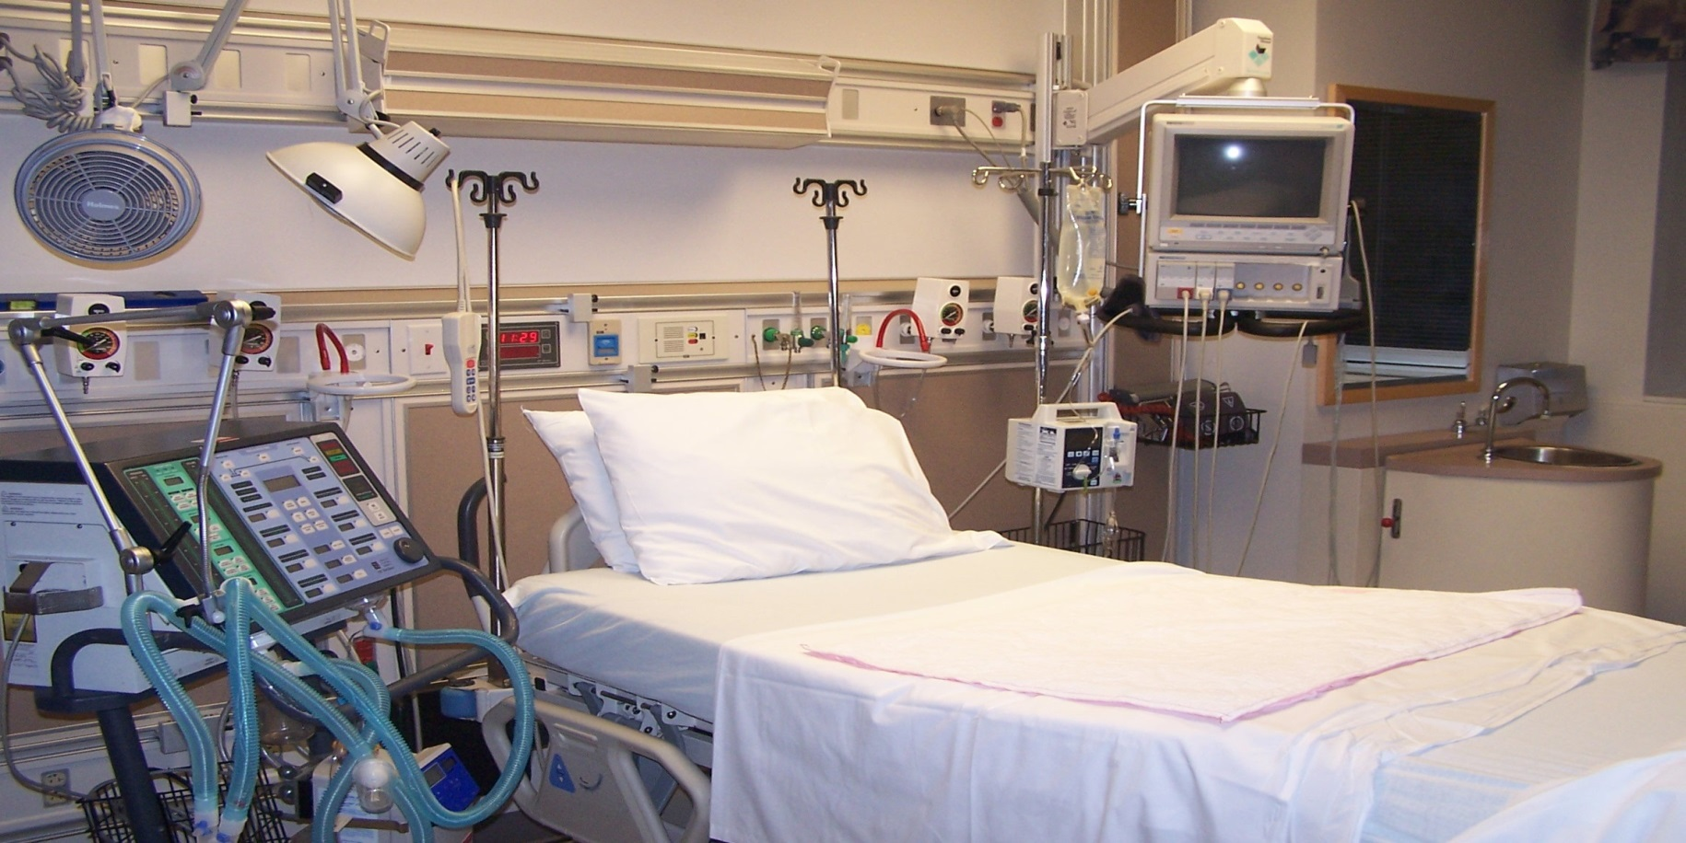
The Patient Data is Here....

Slide 6

But Not Here...............

Slide 7
Initial Use Case (1 of 2)
There are a number of key use case examples, both inpatient and outpatient, all in the clinical environment. One use case was selected based on its relative simplicity in regards to semantic interoperability and also its high volume. That use case involves the monitoring of vital signs in an inpatient setting (ICU, Step Down, Observation, General / Surgical). The patient is transported to a room and is attached to a monitor or monitors to collect the key vital signs as defined by Meaningful Use as a minimum:
Body Temperature
BP Diastolic
BP Systolic
Head Circumference (manual entry)
Heart Rate
Height (manual entry)
Height (Lying)
O2 % BldC Oximetry
Respiratory Rate
Weight Measured

Slide 8
Initial Use Case (2 of 2)
Additional vital signs may be monitored depending on the setting and procedure.
The devices or middleware then collect this data in IEEE 11073-10101 nomenclature for inclusion in PCD-01 Communicate Device Data messages. The PCD Device Observation Filter would filter these messages into an EHR consumable stream of output. A new transaction/profile would convert these data streams into HL7 CDAs accessing a utility that would convert applicable IEEE 1073-10101 nomenclature into LOINC observations and SNOMED post-coordinated applicable nomenclature and constraints.
These CDAs would then be transmitted to the EHR or other clinical system to populate the patient’s clinical record for care management, accountable care, public health, and CQI research purposes.

Slide 9

BENEFITS of
Patient Care Device Clinical and Operations Data Acquisition
Improved workflow
Improved data collection
Improved safety
Improved patient care

Slide 10
Benefits
Improved workflow: Medical device data desired for clinical, operations, clinical quality improvement, population and research purposes could be requested retrospectively or subscribed in advance for publishing to a repository or to a specific clinical application for a specific patient and intervention.
Improved data collection: Data would no longer need to be reentered from the device to the clinical application, effectively eliminating risks of neglecting to implement the data or making transcription errors.
Improved safety: Additional medical device observation data would be available to clinicians.
Improved patient care: Increased observation data would be included in the patient’s chart as well as in near real time for the clinical application for clinical decision support.
In the short term, the benefits would apply to a high volume of work including any inpatient scenario involving devices providing vital sign observations. This would only increase over time as outpatient and patient settings are added and observations are added beyond vital signs. Please note that vital signs benefits of course do not apply to those vital signs that are observed manually such as height.

Slide 11
Proposed Constraints (1 of 2)
Principles
Avoid semantic transformation where possible; work with both nomenclatures to align terminology and value sets with each other (include whole chunks of 11073 10101 nomenclature where possible) – needs to merge into clinical realm - a lot of work done
Use post-coordinated SNOMED concepts where possible to reduce the number of concepts that need to be created and managed; where necessary based on the IEEE 11073 10101 input
Map pre-coordinated concepts and deal with multiple axes
Deal with multiple axes for complex concepts
IEEE overlaps SNOMED CT, LOINC, RxNorm, and UCUM terminology. Initially only the observation identifiers in LOINC (and perhaps SNOMED for constraints) would be addressed but in the future we will address the other areas of overlap. The principle of post-coordinated concept priority is a useful one
Establish an on-going process to ensure device / clinical harmonization over time involving IEEE, IHE, and hopefully NLM (with whom we are currently in discussion, planning for future VA/NLM inter-agency agreements

Slide 12
Proposed Constraints (2 of 2)
Scope Deferred
Use cases beyond inpatient vital signs
Usage with consumer devices
Usage with portable lab devices

Slide 13
Proposed Division of Labor - The Three Components
Device Data Stream and Filtering
IHE PCD
Device Semantic Bridge
(“Chapter 17”)
IHE PCC
IEEE to Concept / Clinical Mapping
VHA
NLM
C4MI
Pilots – VHA, ??

Slide 14
PCD Technical Solution and DCB
Device Observation Filter (DOF)
Subscribe
Device Observation Reporters (DOR)
Network Gateways
Device Integration Engines
Individual Devices
Device Observation Consumers (DOC)
Enterprise EMR, EHR, …
ISO/IEEE 11073 mapping to SNOMED, RxNORM, and/or LOINC
for vital sign and other numerics such as medications from ventilators
Numerics
Waveforms
Annotations
Events
Alerts
Configuration
Commands
IHE PCD DEC*
IHE PCD DEC
WCM*, ACM*, …
*
DEC = Device Enterprise Communication
WCM = Waveform Content Module
ACM = Alert Communication Management
(HL7 V2.6 messaging and ISO/IEEE 11073 nomenclatures)

Slide 15
PCD Technical Solution
Enterprise gateways, device integration engines (e.g. Capsule, iSiron, Nuvon) and possibly individual devices send near real-time medical device data using the IHE PCD DEC Profiles (HL7 V2.6 messaging and ISO/IEEE 11073 nomenclatures.
For numeric vital signs observations, a normative mapping from ISO/IEEE 11073 to SNOMED and/or LOINC are developed (by organizations representing SNOMED and/or LOINC) and are made available on the NIST RTMMS and other nomenclature repositories. Enterprise “Device Observation Consumers” would use the normative mapping table to translate the ISO/IEEE 11073 nomenclature to SNOMED and/or LOINC.
Device-centric data (waveforms, events, alerts, configuration and commands) would use the ISO/IEEE 11073 nomenclature.
The IHE PCD DEC (Device Enterprise Communication) Technical Framework and ISO/IEEE 11073 nomenclature are recognized as “Meaningful Use” profiles and standards for medical device data transfer to and from enterprise entities.

Slide 16
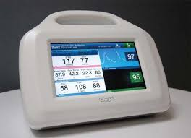
PCD IHE Actors Diagram (Current State)
2
Device Observation Filter (DOF)
PCD-01: Communicate Device Data
PCD-02: Subscribe to PCD Data
Device Observation Reporter (DOR)
1
Device Observation Consumer (DOC)
3
4
PCD-01: Communicate Device Data
“no filter option”

Slide 17
Use Case Steps
Key steps* include:
DOC Subscription for a Data Stream to a DOF
Patient, patient location, device class, device parameters
Begin time, intervals, end time
Device sends data to DOR
DOR sends observation stream to DOF
DOF sends filtered stream to DOC
If no filtering needed, the steps are 2. and then a revised 4.
DOR sends stream to DOC

Slide 18
IHE Actors Diagram (Straw man Future Incremental State)
PCD DEC
PCC DCB
PCD-02: Subscribe to PCD Data
2
PCD-01: Communicate Device Data
1
Device Observation Filter (DOF)
Device Observation Bridge (DOB)
PCD-01
PCD-01
TBD
Device Observation Consumer (DOC)
Device Clinical Consumer (DCC)
Device Observation Reporter (DOR)
3
4
5
6
HL7 v2.6
HL7 v2.6
HL7 v2.6
“CDA”
Applications
Care Management
Clinical Decision Support
Accountable Care
Public Health
Clinical Quality Improvement
HL7 CTS2
“no filter option”
Data Transform Utility

Slide 19
Use Case Steps
Key steps include:
DOC Subscription for a Data Stream to a DOF
Patient, patient location, device class, device parameters
Begin time, intervals, end time
Device sends data to DOR
DOR sends observation stream to DOF
DOF filters stream to retain what is useful for clinical work and sends filtered stream to DOC
DOC sends stream to DOB which maps clinical observations from filtered HL7 v2.6 messages, invoking a data transformation utility to perform data transformations required for LOINC and SNOMED nomenclatures
DOB sends filtered and transformed stream to DCC

Slide 20
Standards & Systems (1 of 2)
Nomenclatures / Terminologies Used:
Device (IHE PCD Technical Framework Volume 3 – Semantic Content)
IEEE 11073 10101 Nomenclature
MDC terms
Clinical (CDA) *
LOINC (observations)
SNOMED (constraints primarily)
RxNorm (anesthesia drugs)
UCUM (units of measure)
Device Information Model (DIM) – how a device maps to a hierarchical, containment tree model – GMDN. MDNS assumed in use but being phased out
* FHIR impact anticipated as Consolidated CDA specifications will migrate to FHIR resource definitions

Slide 21
Standards & Systems (2 of 2)
Messaging
HL7 V2.6 constrained by IHE DEC PCD-01 and RTM – Device
CDA - Clinical
Message Transport
Minimum Lower Layer Protocol (MLLP) over TCP/IP – Device Operations
Web Services(REST/SOAP) - Clinical Observations
Systems Impacted
EHRs primarily currently
Over time: Clinical Decision Support, Population Management, Clinical Research

Slide 22
Content Type and Direction
Type of Interaction | Nomenclature – Device Side | Nomenclature – Clinical Side
Device Numerics Export | IEEE 11073 10101 | LOINC (observations) SNOMED (coordination)
Device Waveforms Export | IEEE 11073 10101 | IEEE 11073 10101
Device Annotations Export | IEEE 11073 10101 | IEEE 11073 10101
Device Events Export | IEEE 11073 10101 | IEEE 11073 10101
Device Alerts Export | IEEE 11073 10101 | IEEE 11073 10101

Slide 23
The initial value set
Specified in the HTSP C80 Vital Signs Results value set specification (2.16.840.1.113883.3.88.12.80.62) :
https://phinvads.cdc.gov/vads/ViewValueSet.action?oid=2.16.840.1.113883.3.88.12.80.62
LOINC Concept Code | Concept Name | Preferred Concept Name
8310-5 | Body Temperature | Body temperature:Temp:Pt:^Patient:Qn:
8462-4 | BP Diastolic | Intravascular diastolic:Pres:Pt:Arterial system:Qn:
8480-6 | BP Systolic | Intravascular systolic:Pres:Pt:Arterial system:Qn:
8287-5 | Head Circumference | Circumference.occipital-frontal:Len:Pt:Head:Qn:Tape measure
8867-4 | Heart Rate | Heart beat:NRat:Pt:XXX:Qn:
8302-2 | Height | Body height:Len:Pt:^Patient:Qn:
8306-3 | Height (Lying) | Body height^lying:Len:Pt:^Patient:Qn:
2710-2 | O2 % BldC Oximetry | Oxygen saturation:SFr:Pt:BldC:Qn:Oximetry
9279-1 | Respiratory Rate | Breaths:NRat:Pt:Respiratory system:Qn:
3141-9 | Weight Measured | Body weight:Mass:Pt:^Patient:Qn:Measured

Slide 24
Vital Sign Observation Vocabulary Qualifiers / Constraints
Constraints (MU2 C-CDA) | Device Side (MDC Term Codes – IHE PCD Tech Framework Volume 3 Semantic Content) | Clinical Side Requirements (assume 1 instance unless otherwise noted) | Clinical Side Term Codes
classCode |  | SHALL | OBS
moodCode |  | SHALL | EVN
templateID |  | SHALL
Id |  | SHALL / 1 to Many
Code (vital sign result type) |  | SHALL
Text (including link potential) |  | SHOULD
statusCode (completed) |  | SHALL | (ActStatus) = completed
effectiveTime |  | SHALL
value |  | SHALL
InterpretationCode (qualifier) |  | MAY
methodCode (qualifier) |  | MAY
targetSiteCode (qualifier) |  | MAY
author |  | MAY
Encoded values come from SNOMED
UCUM used for Units of Measure |  | yes

